Slide 1
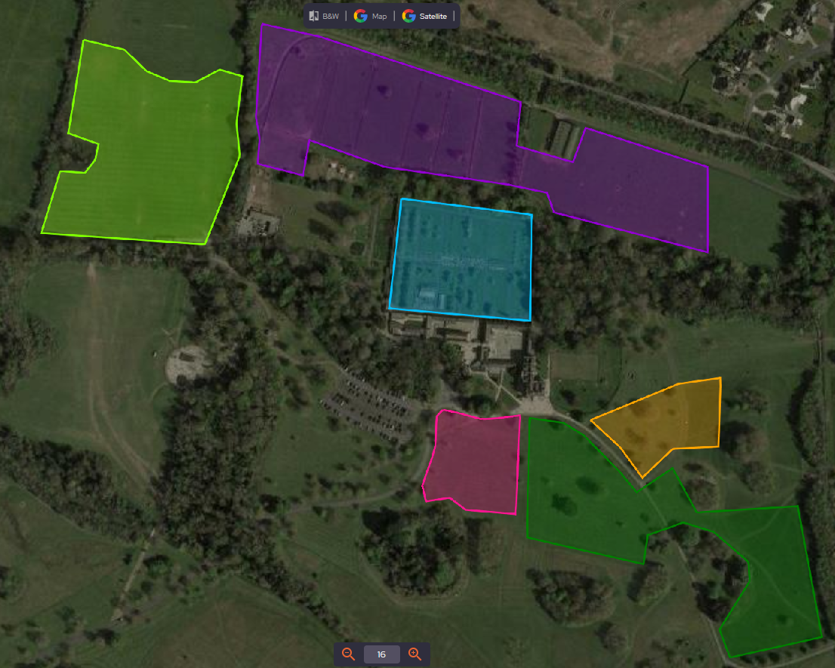
MAP TITLE – FCC– Flavours of Fingal - Donabate
Site Layout – Zoned Areas
REVISION - 001
KEY
Zones
Zone 2 - Paddock’s Area
Zone 1 - County Show
Zone 1 - County Show
Zone 2 - Paddock’s Area
Zone 3 - Walled Garden Area
Zone 4 - Front of House Area
Zone 5 - Living History Area
Zone 6 - Equestrian Area
Zone 3 - Walled Garden Area
Zone 5 - Living History Area
Zone 4 - Front of House Area
Zone 6 - Equestrian Area
EVENT – Flavours of Fingal - Donabate
MAP BY – NK
DATE – 10.01.2024
SCALE – Not Scaled

